Slide 1
UNIT-I
Introduction & Physical Layer

Slide 2
Contents
Introduction:
Network, Uses of Networks,
Types of Networks
Reference Models: TCP/IP Model, The OSI Model,
Comparison of the OSI and TCP/IP reference model
Architecture of Internet.
Physical Layer:
Guided transmission media,
Wireless transmission media,
Switching

Slide 3
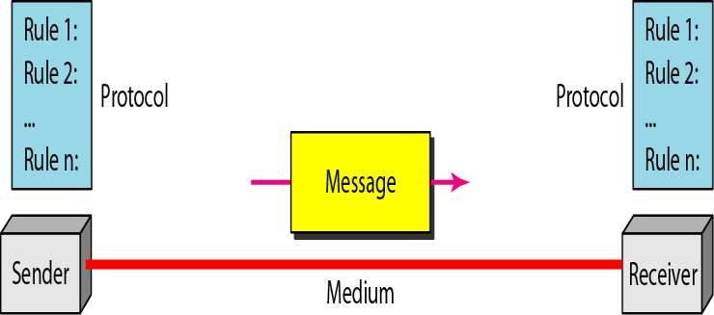
Introduction: A data communications system has five components
Message: Information(data) to be communicated
Sender
Receiver
Transmission Medium - Physical path by which a message travels
Protocol - A protocol is a set of rules that govern data communications. It represents an agreement between the communicating devices.

Slide 4
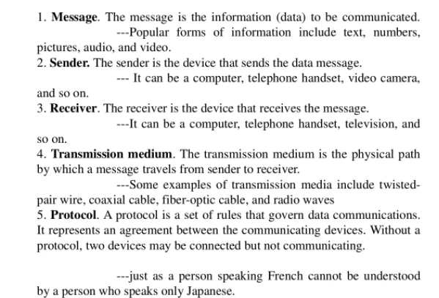
Contd..

Slide 5
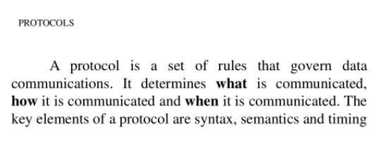
Contd..

Slide 6
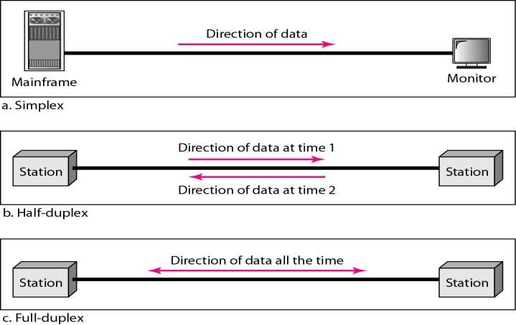
Data Flow
Communication between two devices can be simplex, half-
duplex, or full-duplex as shown in Figure.

Slide 7
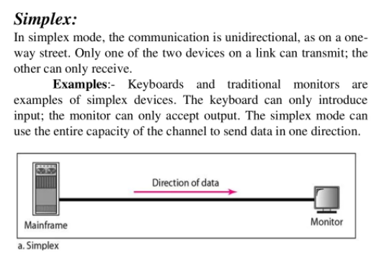

Slide 8
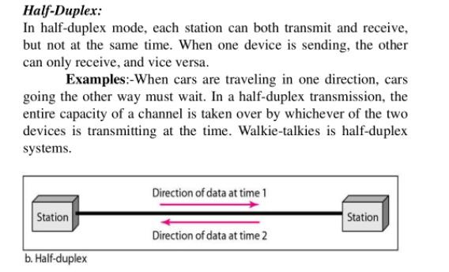

Slide 9
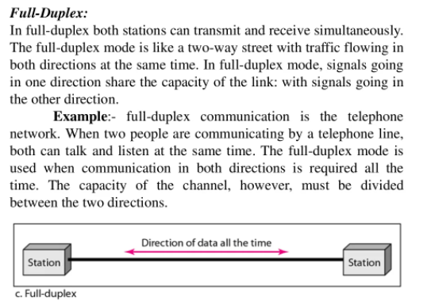

Slide 10
NETWORK
A network is a set of devices (often referred to as nodes) connected by communication links.
A node can be a computer, printer, or any other device capable of sending and/or receiving data generated by other nodes on the network.
A link can be a cable, air, optical fiber, or any medium which
can transport a signal carrying information.

Slide 11
Network Criteria
A network must be able to meet a certain number of criteria. The most
important of these are performance, reliability, and security
Performance
Depends on Network Elements
Measured in terms of Delay and Throughput
Reliability
Measured by the frequency of failure, the time it takes a link to
recover from a failure.
Measured in terms of availability/robustness
Security
Protecting data from unauthorized access.
Implementing policies and procedures for recovery from data losses.

Slide 12
USES OF NETWORKS
Business Applications
Resource sharing
Client-Server model.
Desktop sharing
E-commerce
IP telephony or Voice over IP (VoIP)
Home Applications
peer-to-peer communication
person-to-person communication
electronic commerce
entertainment.(game playing,)

Slide 13
USES OF NETWORKS
Mobile Users
Text messaging or texting
Smart phones,
GPS (Global Positioning System)
m-commerce
Social Issues
with the good comes the bad, as this new-found freedom brings with it
many unsolved social,)
BOTNET ATTACK: (send spam) political, and ethical issues.

Slide 14
Network Topologies
The network topology is the method for arrangement of computing devices or networking devices through which they are connected (Wired or Wireless) or Physical arrangement of various nodes in the network
There are almost six types of topologies which are employed for networking of computing devices (Computers or networking devices)
1. Bus 2. Ring 3. Star 4. Mesh
5. Tree 6. Hybrid

Slide 15
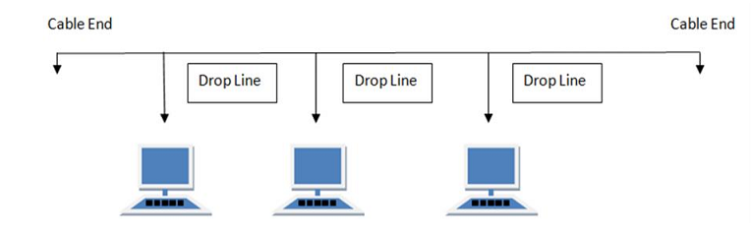
Bus Topology
Bus topology is a network type in which every computer and networking device is connected to single cable

Slide 16
Features
Data transmission is in one direction only
Each device is connected to single cable
Advantages
Cost effective (Cheap)
Cable required is less when compared to other topologies.
Easy to expand network (by joining two cables together)
Disadvantages
When cable fails then whole network fails
Performance of topology decreases with increase in nodes and traffic

Slide 17
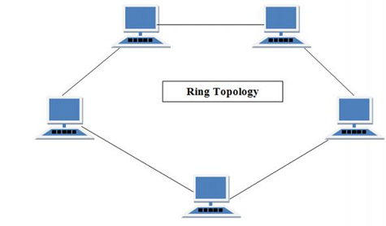
Ring Topology
It is called as ring topology because it forms a ring as each computer is connected to the other computer with last one connected to first.
Ring topology has exactly two neighbors for each node

Slide 18
Features
Number of repeaters are used and transmission is unidirectional
Data transfer is bit by bit (sequential Manner)
Advantages
Performance of network is not effected by increase in traffic or by adding nodes as the nodes have the tokens only can participate in communication.
Cheap to install and expand.
Disadvantages
Trouble shooting is difficult
Additions and deletions of nodes will disturb network activity.
Failure of one computer will disturb entire network

Slide 19
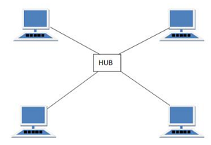
Star Topology
All computers in this topology are connected to a single hub through the cable and this hub is the central node.
All other nodes are to be connected to the central hub in the case of extending the network

Slide 20
Features
Every node has its own dedicated connection to the hub.
Acts as repeater for data flow.
Advantages
Hubs can be easily upgraded.
Easy to trouble shoot, setup and modify the network.
In the case of failure only failure node is effected reaming network will function smoothly.
Disadvantages
High Cost.
If the hub is effected then functioning whole network is disturbed.

Slide 21
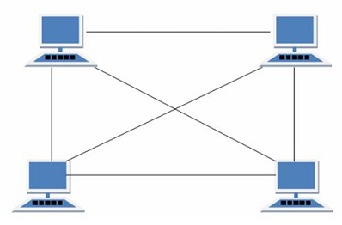
Mesh Topology
It is a point to point connection to all other computers.
Traffic is carried only between two nodes to which it is connected

Slide 22
Features
Fully Connected
Robust.
Advantages
Each connection can carry its own data.
Fault diagnosis is easy.
Provides security and privacy.
Disadvantages
Installation and configuration is difficult.
Cabling cost is more.
Bulk wiring is required.

Slide 23
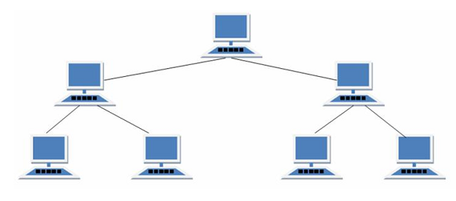
Tree Topology
It has a root node and all other nodes are connected to the root node forming hierarchy and it is also called as hierarchical topology.
It should have atleast three levels for the hierarchy

Slide 24
Features
Ideal if work stations are located in groups
Used in wide area networks.
Advantages
Easy error detection.
Expansion of nodes is possible and easy.
Easy to maintain and manage.
Disadvantages
Costly and heavily cabled.
Addition of more nodes increases difficulty in maintenance.
Failure of root effects all nodes in the network.

Slide 25
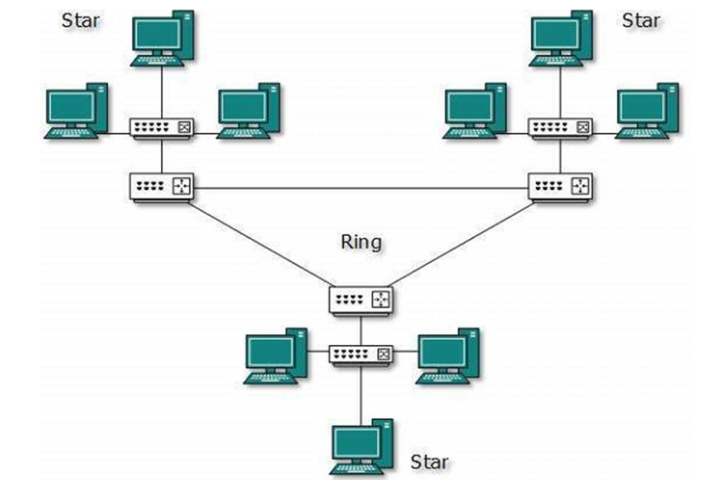
Hybrid Topology
A network structure whose design contains more that one topology is referred as hybrid topology.

Slide 26
Features
Combinations of two or more topologies
Inherits the advantages and disadvantages of the topologies included.
Advantages
Reliable as error correction and trouble shooting is easy.
Scalable (Size can be increased and decreased easily).
Disadvantages
Costly.
Complex Design.

Slide 27
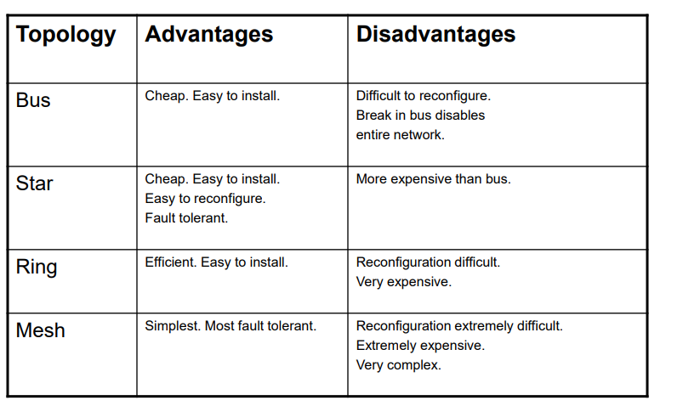
Comparison of Network Topologies

Slide 28
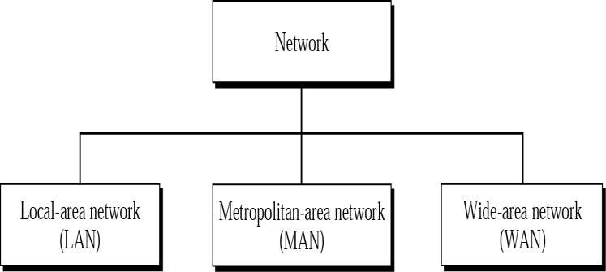
Types of Networks
The types of network are classified based upon the size, the area it covers and its physical architecture. The three primary network categories are LAN, WAN and MAN.

Slide 29
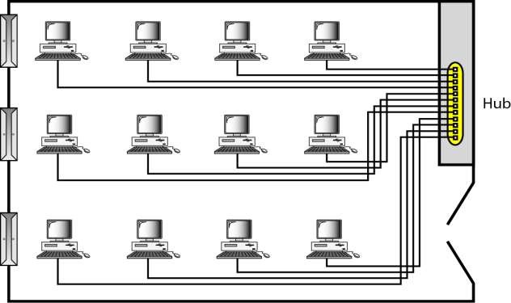
Local Area Networks (LANs)
Short distances
Designed to provide local interconnectivity

Slide 30
Local Area Networks (LANs)
Local Area Network is a group of computers connected to each other in a small area such as building, office.
LAN is used for connecting two or more personal computers through a communication medium such as twisted pair, coaxial cable, etc.
It is less costly as it is built with inexpensive hardware such as hubs, network adapters, and ethernet cables.
The data is transferred at an extremely faster rate in Local Area Network.
Local Area Network provides higher security.

Slide 31
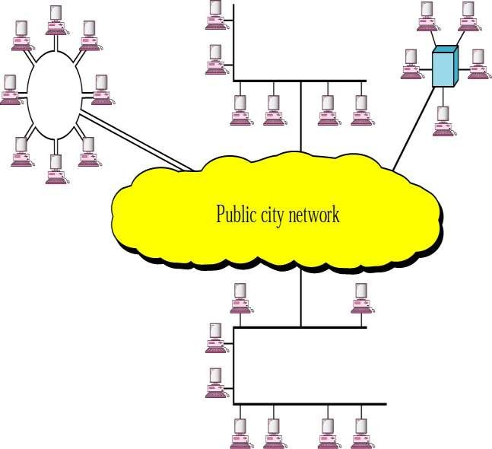
Metropolitan Area Networks (MANs)
Designed to extend to an entire city
Cable TV network, a company’s connected LAN’s

Slide 32
Metropolitan Area Networks (MANs)
A metropolitan area network is a network that covers areas with in the city by interconnecting a different LAN to form a larger network.
Government agencies use MAN to connect to the citizens and private industries.
In MAN, various LANs are connected to each other through a telephone exchange line.
The most widely used protocols in MAN are RS-232, Frame Relay, ATM, ISDN, OC-3, ADSL, etc.
It has a higher range than Local Area Network(LAN).
Uses Of Metropolitan Area Network:
MAN is used in communication between the banks in a city.
It can be used in an Airline Reservation.
It can be used in a college within a city.
It can also be used for communication in the military.

Slide 33
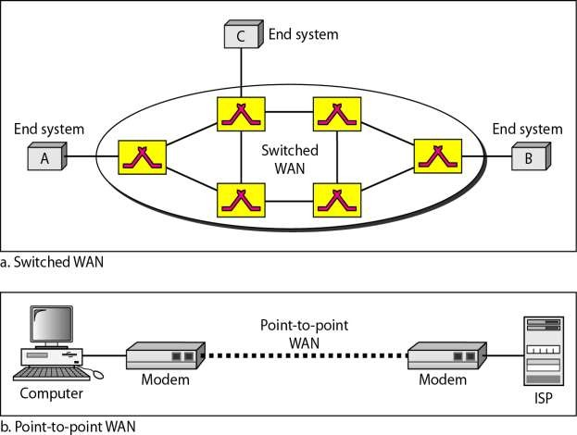
Wide Area Networks(WANs)
Long distance transmission, e.g., a country, a continent,
the world

Slide 34
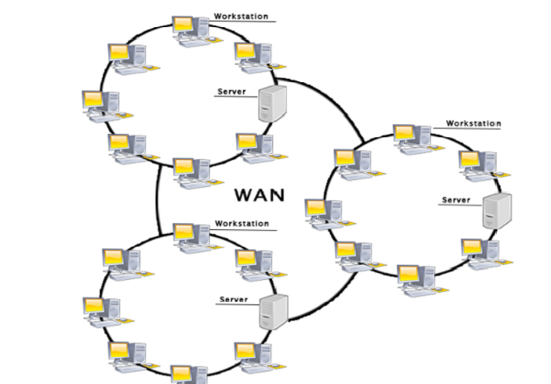

Slide 35
Wide Area Networks(WANs)
A Wide Area Network is a network that extends over a large geographical area such as states or countries.
A Wide Area Network is quite bigger network than the LAN.
. A Wide Area Network is not limited to a single location, but it spans over a large geographical area through a telephone line, fiber optic cable or satellite links.
The internet is one of the biggest WAN in the world.
A Wide Area Network is widely used in the field of Business, government, and education.

Slide 36
Advantages Of Wide Area Network:
Following are the advantages of the Wide Area Network:
Geographical area: A Wide Area Network provides a large geographical area. Suppose if the branch of our office is in a different city then we can connect with them through WAN. T.
Centralized data: In case of WAN network, data is centralized. Therefore, we do not need to buy the emails, files or back up servers.
Get updated files: Software companies work on the live server. Therefore, the programmers get the updated files within seconds.
Exchange messages: In a WAN network, messages are transmitted fast. The web application like Facebook, Whatsapp, Skype allows you to communicate with friends.
Sharing of software and resources: In WAN network, we can share the software and other resources like a hard drive, RAM.
Global business: We can do the business over the internet globally.
High bandwidth: If we use the leased lines for our company then this gives the high bandwidth. The high bandwidth increases the data transfer rate which in turn increases the productivity of our company.

Slide 37
Disadvantages of Wide Area Network:
The following are the disadvantages of the Wide Area Network:
Security issue: A WAN network has more security issues as compared to LAN and MAN network as all the technologies are combined together that creates the security problem.
Needs Firewall & antivirus software: The data is transferred on the internet which can be changed or hacked by the hackers, so the firewall needs to be used. Some people can inject the virus in our system so antivirus is needed to protect from such a virus.
High Setup cost: An installation cost of the WAN network is high as it involves the purchasing of routers, switches.
Troubleshooting problems: It covers a large area so fixing the problem is difficult.

Slide 38











































Reference Models : OSI Model, TCP/IP Model,
LAYERED TASKS
We use the concept of layers in our daily life. As an example, let us consider two friends who communicate through postal mail. The process of sending a letter to a friend would be complex if there were no services available from the post office.

Slide 39
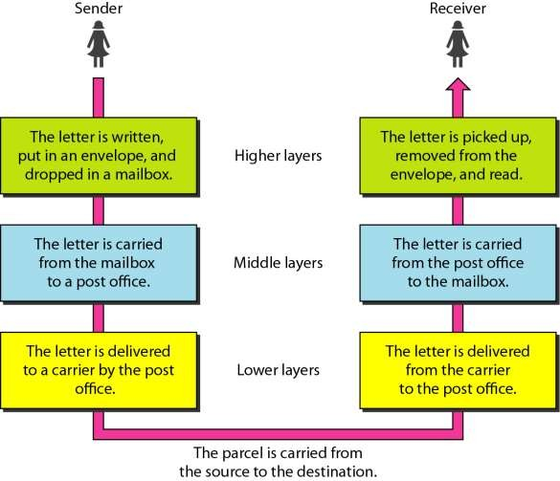
Tasks involved in sending a letter

Slide 40
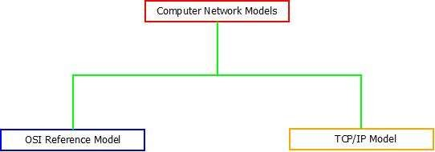
Reference Models : OSI Model, TCP/IP Model,
Computer network reference models are responsible for establishing a connection among the sender and receiver and transmitting the data in a smooth manner respectively.
There are two computer network models i.e. OSI Model and TCP/IP
Model on which the whole data communication process relies.

Slide 41
OSI Reference Model
OSI stands for Open Systems Interconnection
Created by International Standards Organization (ISO)
Was created as a framework and reference model to explain how different
networking technologies work together and interact
It is not a standard that networking protocols must follow
OSI model is called as “Open Source” because of its “fit anywhere” ability. Any connection can be established using the OSI model unless and until any protocols are not used as OSI model does not support protocol establishment. It runs without the use of protocols
Each layer has specific functions it is responsible for
All layers work together in the correct order to move data around a network

Slide 42
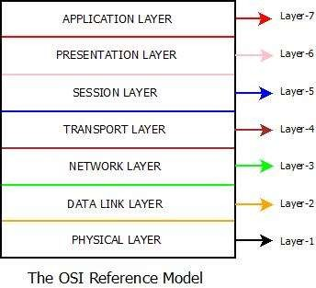
Seven layers of the OSI model
2.23

Slide 43
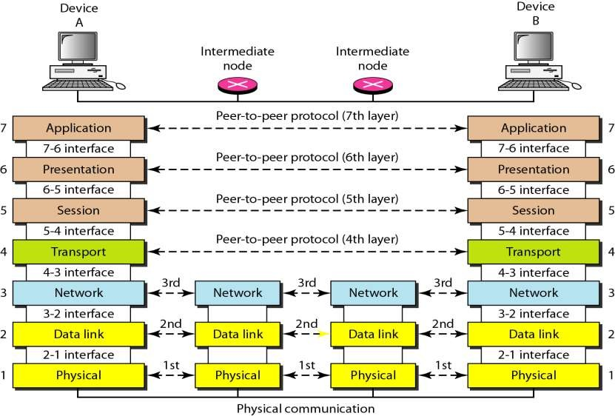
Computer Network Models : Architecture And Layers of OSI Reference Model

Slide 44
Physical Layer (Layer 1) :
The lowest layer of the OSI reference model is the physical layer. It is responsible for the actual physical connection between the devices.
The physical layer contains information in the form of bits. It is responsible for transmitting individual bits from one node to the next.
When receiving data, this layer will get the signal received and convert it into 0s and 1s and send them to the Data Link layer, which will put the frame back together.
Hub, Repeater, Modem, Cables are Physical Layer devices.

Slide 45
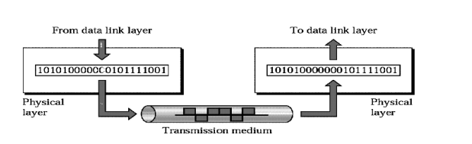
Physical Layer (Layer 1) :
The physical layer coordinates the functions required to transmit a bit stream over a physical medium.

Slide 46
Physical Layer (Layer 1) :
The functions of the physical layer are :
Bit synchronization: The physical layer provides the synchronization of the bits by providing a clock. This clock controls both sender and receiver thus providing synchronization at bit level.
Bit rate control: The Physical layer also defines the transmission rate i.e. the
number of bits sent per second.
Physical topologies: Physical layer specifies the way in which the different, devices/nodes are arranged in a network i.e. bus, star or mesh topolgy.
Transmission mode: Physical layer also defines the way in which the data flows between the two connected devices. The various transmission modes possible are: Simplex, half-duplex and full-duplex.

Slide 47
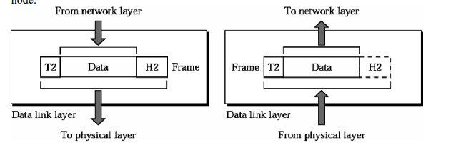
Data Link Layer (DLL) (Layer 2) :
It is responsible for transmitting frames from one node to next node.

Slide 48
Data Link Layer (DLL) (Layer 2) :
The data link layer is responsible for the node to node delivery of the
message.
The main function of this layer is to make sure data transfer is error-
free from one node to another, over the physical layer.
When a packet arrives in a network, it is the responsibility of DLL to
transmit it to the Host using its MAC address.
Data Link Layer is divided into two sub layers :
Logical Link Control (LLC)
Media Access Control (MAC)

Slide 49
Data Link Layer (DLL) (Layer 2) :
Logical Link Control (LLC)
The packet received from Network layer is further divided into frames depending on the frame size of NIC(Network Interface Card).
DLL also encapsulates Sender and Receiver’s MAC address in the
header.
Media Access Control (MAC)
The Receiver’s MAC address is obtained by placing an ARP(Address Resolution Protocol) request onto the wire asking “Who has that IP
address?” and the destination host will reply with its MAC address.
The functions of the data Link layer are : - Framing, Physical addressing , Error control, Flow Control, Access control.
Switch & Bridge are Data Link Layer devices.

Slide 50
Data Link Layer (DLL) (Layer 2) :
Framing - Divides the stream of bits received into data units called frames.
Physical addressing – If frames are to be distributed to different systems on the n/w , data link layer adds a header to the frame to define the sender and receiver.
Flow control- If the rate at which the data are absorbed by the receiver is less than the rate produced in the sender ,the Data link layer imposes a flow ctrl mechanism.
Error control- Used for detecting and retransmitting damaged or lost frames and to prevent duplication of frames. This is achieved through a trailer added at the end of the frame.
Access control -Used to determine which device has control over the link at any given time.

Slide 51
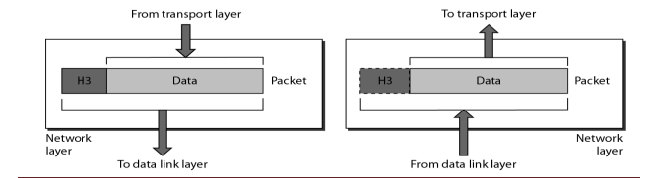
Network Layer (Layer 3) :
It is mainly required, when it is necessary to send information from one network to another.

Slide 52
Network Layer (Layer 3) :
Network layer works for the transmission of data from one host
to the other located in different networks
The functions of the Network layer are
:
Routing:– The devices which connects various networks called routers are responsible for delivering packets to final destination. The network layer protocols determine which route is suitable from source to destination.
Logical Addressing: The sender & receiver’s IP address are placed in the header by network layer. Such an address distinguishes each device uniquely and universally.
* Segment in Network layer is referred as Packet.

Slide 53
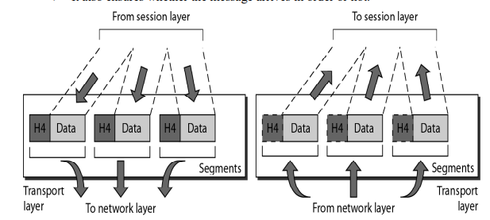
Transport Layer(Layer 4) :

Slide 54
Transport Layer(Layer 4) :
This layer accepts the message from the (session) layer , breaks the message into smaller units . Each of the segment produced has a header associated with it. The transport layer at the destination station reassembles the message.
In order to deliver the message to correct process, transport layer header includes a type of address called service point address or port address.
May use a connection-oriented protocol such as TCP to ensure
destination received segments
May use a connectionless protocol such as UDP to send segments without assurance of delivery

Slide 55
Functions of Transport Layer(Layer 4) :
Port addressing – The header in this must therefore include a address called port address. This layer gets the entire message to the correct process on that computer.
Segmentation and reassembly - The message is divided into segments and each segment is assigned a sequence number. These numbers are arranged correctly on the arrival side by this layer.
Connection control - This can either be connectionless or connection-oriented. The connectionless treats each segment as a individual packet and delivers to the destination. The connection-oriented makes connection on the destination side before the delivery. After the delivery the termination will be terminated.
Flow and error control - Similar to data link layer, but process to process take place.

Slide 56
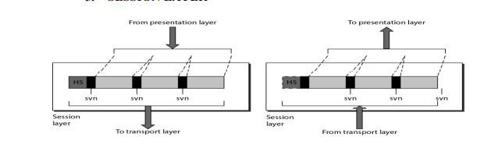
Session Layer (Layer 5) :

Slide 57
Session Layer (Layer 5) :
This layer is responsible for establishment of connection,
maintenance of sessions, authentication and also ensures security.
The session layer allows two systems to start communication with each other in half-duplex or full-duplex.
This layer allows a process to add checkpoints which are considered
as synchronization points into the data.
These synchronization point help to identify the error so that the data
is re-synchronized properly and data loss is avoided

Slide 58
Functions of Session layer
Dialog control - This session allows two systems to enter into a dialog either in half duplex or full duplex.
Synchronization -This allows to add checkpoints into a stream of data.

Slide 59
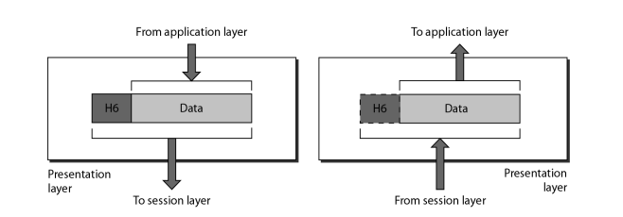
Presentation Layer (Layer 6) :
It is concerned with the syntax and semantics of information exchanged between two systems.

Slide 60
Presentation Layer (Layer 6) :
The data from the application layer is extracted here and manipulated
as per the required format to transmit over the network.
The functions of the presentation layer are :
Translation : For example, ASCII to EBCDIC.
Encryption/ Decryption : Data encryption translates the data into another form or code. The encrypted data is known as the cipher text and the decrypted data is known as plain text. A key value is used for encrypting as well as decrypting data.
Compression: Reduces the number of bits that need to be transmitted
on the network.

Slide 61
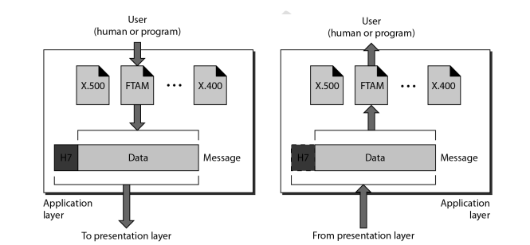
Application Layer (Layer 7) :

Slide 62
Application Layer (Layer 7) :
Contains all services or protocols needed by application software or
operating system to communicate on the network.
The other responsibilities of this layer are
FTAM(file transfer,access,mgmt) - Allows user to access files in a remote host.
Mail services - Provides email forwarding and storage.
Directory services - Provides database sources to access information about various sources and objects
Examples
–Firefox web browser uses HTTP (Hyper-Text Transport
Protocol)
–E-mail program may use POP3 (Post Office Protocol version 3) to read e-mails and SMTP (Simple Mail Transport Protocol) to send e-mails

Slide 63
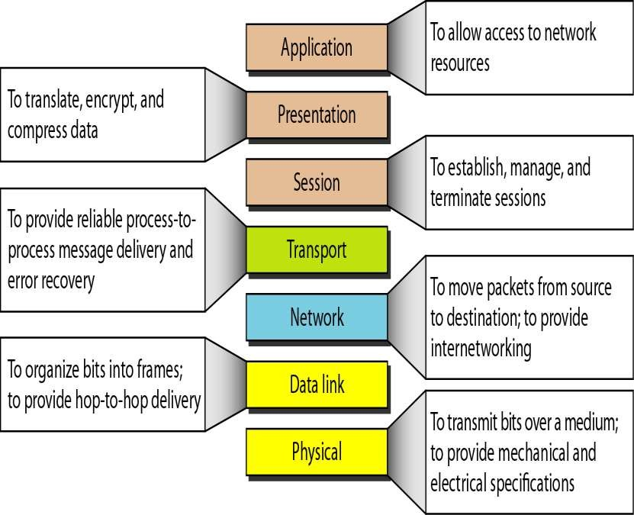
SUMMARY:

Slide 64
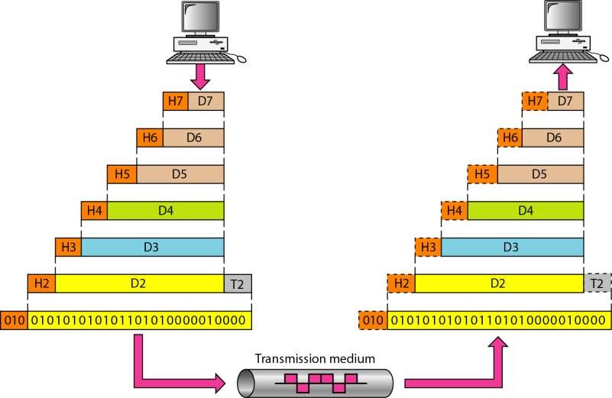
An exchange using the OSI model

Slide 65
TCP/IP Model(Transmission Control Protocol/Internet Protocol)
The OSI Model we just looked at is just a reference/logical model. It was designed to describe the functions of the communication system by dividing the communication procedure into smaller and simpler components.
But when we talk about the TCP/IP model, it was designed and developed by Department of Defense (DoD) in 1960s and is based on standard protocols.
The TCP/IP model is a concise version of the OSI model. It contains
four layers, unlike seven layers in the OSI model. The layers are:

Slide 66
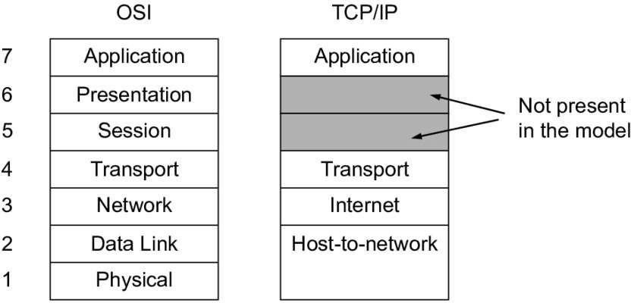
TCP/IP Model(Contd..)
The four layers in the TCP/IP protocol suite are −

Slide 67
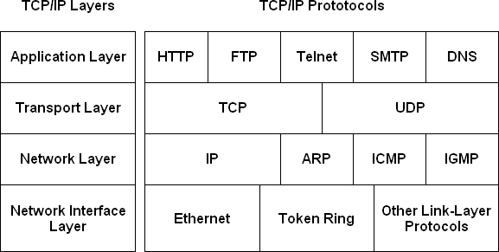

Slide 68
Application Layer
Application layer protocols define the rules when implementing specific
network applications
FTP – File Transfer Protocol – used for file transfer
Telnet – Remote terminal protocol
For remote login on any other computer on the network
SMTP – Simple Mail Transfer Protocol
used to provide e-mail services.
HTTP – Hypertext Transfer Protocol
For Web browsing
DNS – Domain Name System
The protocol that allows you to refer to
computers by using names rather than numbers.
other
host

Slide 69
Transport layer
The Transport layer is where sessions are established and data packets are exchanged between hosts. Two core protocols are found at this layer:
Transmission Control Protocol (TCP):
Provides reliable connection oriented transmission between two hosts. TCP establishes a session between hosts, and then ensures delivery of packets between the hosts.
User Datagram Protocol (UDP):
Provides connectionless, unreliable, one-to-one or one-to-many
delivery.

Slide 70
Network layer
The Network layer is where data is addressed, packaged, and routed among
networks. Several important Internet protocols operate at the Network layer:
Internet Protocol (IP):
A routable protocol that uses IP addresses to deliver packets to network devices. IP is an intentionally unreliable protocol, so it does not guarantee delivery of information.
Address Resolution Protocol (ARP):
Resolves IP addresses to hardware MAC addresses.
Internet Control Message Protocol (ICMP):
Sends and receives diagnostic messages.

Slide 71
Network interface layer
The lowest level of the TCP/IP architecture is the Network Interface layer. It corresponds to the OSI's Physical and Data Link layers.
You can use many different TCP/IP protocols at the Network Interface layer, including Ethernet and Token Ring for local area networks and protocols such as X.25, Frame Relay, and ATM for wide area networks.

Slide 72
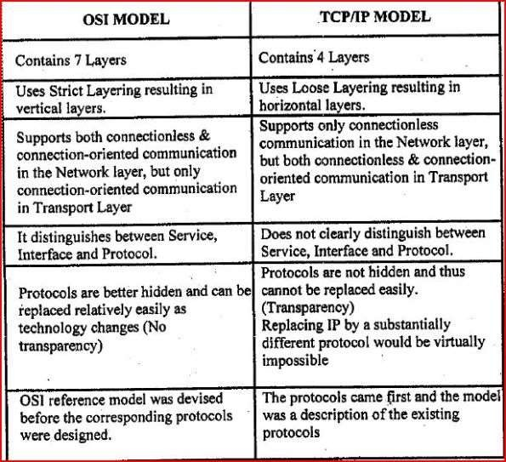

Slide 73
UNIT I-Part-2
Physical Layer

Slide 74
1. Transmission Media
What is Transmission Media ?
In data communication,
A transmission medium can be broadly defined as anything that can carry information from a source to a destination.
We use different types of cables or waves to transmit data.
Data is transmitted normally through electrical or electromagnetic signals.

Slide 75
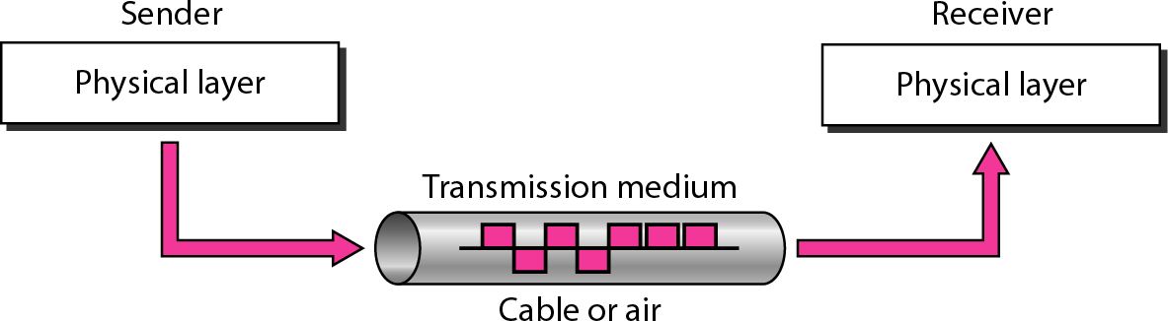
Transmission media are located below the physical layer

Slide 76
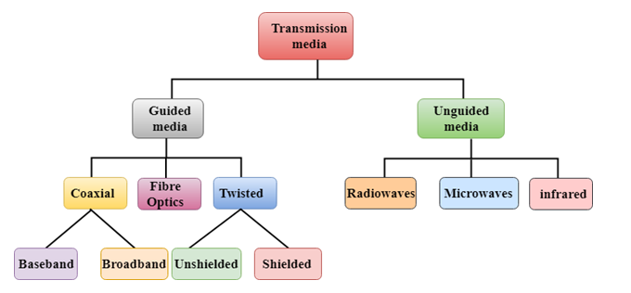
Classification of Transmission media

Slide 77
Contd..
Some factors need to be considered for designing the transmission media are:
Bandwidth: the greater the bandwidth of a medium, the higher the data transmission rate of a signal.
Transmission impairment: When the received signal is not identical to the transmitted one due to the transmission impairment. The quality of the signals will get destroyed due to transmission impairment.
Interference: An interference is defined as the process of disrupting a signal when it travels over a communication medium on the addition of some unwanted signal.

Slide 78
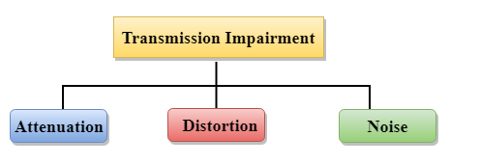
Causes Of Transmission Impairment:
Attenuation: Attenuation means the loss of energy, i.e., the strength of the signal decreases with increasing the distance which causes the loss of energy.
Distortion: Distortion occurs when there is a change in the shape of the signal. This type of distortion is examined from different signals having different frequencies. Each frequency component has its own propagation speed, so they reach at a different time which leads to the delay distortion.
Noise: When data is travelled over a transmission medium, some unwanted signal is added to it which creates the noise.

Slide 79
Guided Media
It is defined as the physical medium through which the signals are transmitted. It is also known as Bounded media.
Types Of Guided media:
1. Twisted pair cable:
Twisted pair is a physical media made up of a pair of cables twisted with each other. A twisted pair cable is cheap as compared to other transmission media. Installation of the twisted pair cable is easy, and it is a lightweight cable. The frequency range for twisted pair cable is from 0 to 3.5KHz.
A twisted pair consists of two insulated copper wires arranged in a regular spiral pattern.
The degree of reduction in noise interference is determined by the number of turns per foot. Increasing the number of turns per foot decreases noise interference.

Slide 80
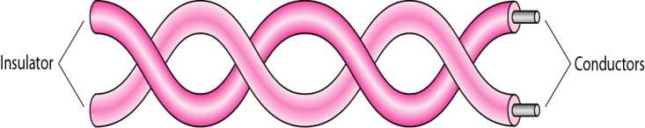
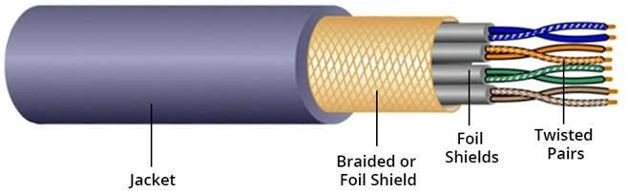
1.Twisted-pair cable
A twisted pair consists of two conductors (normally copper), each with its own plastic insulation, twisted together.
One of the wires is used to carry signals to the receiver, and
the other is used only as a ground reference.

Slide 81
Twisted-pair cable(contd.)
Advantages:
Applications
Very common medium
Can be use in telephone network
Connection Within the buildings
For local area networks (LAN)
Cheap
Easy to work with
Disadvantages:
Low data rate
Short range

Slide 82
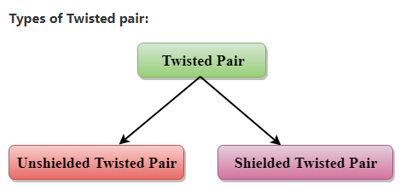
Contd..

Slide 83
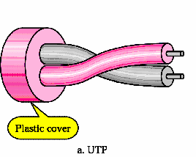
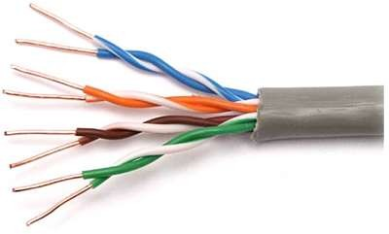
i). Unshielded Twisted-Pair Cable
The most common twisted-pair cable used in communications is
referred to as unshielded twisted-pair (UTP).
Pair of unshielded wires wound around each other
Easy to install

Slide 84
i). Unshielded Twisted-Pair Cable
An unshielded twisted pair is widely used in telecommunication. Following are the categories of the unshielded twisted pair cable:
Category 1: Category 1 is used for telephone lines that have low-speed data.
Category 2: It can support up to 4Mbps and it is suitable for voice data communication.
Category 3: It can support up to 16Mbps.
Category 4: It can support up to 20Mbps. Therefore, it can be used for long-distance communication.
Category 5: It can support up to 200Mbps and it is used in local area network.

Slide 85
Contd..
advantages Of Unshielded Twisted Pair:
It is cheap.
Installation of the unshielded twisted pair is easy.
It can be used for high-speed LAN.
Disadvantage:
This cable can only be used for shorter distances because of attenuation.

Slide 86
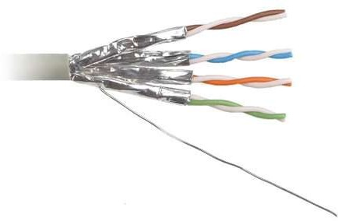
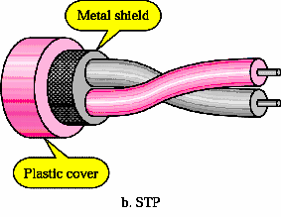
ii). Shielded Twisted Pair(STP)
STP cable has a metal foil or braided mesh covering that encases each
pair of insulated conductors.
A shielded twisted pair is a cable that contains the mesh surrounding the wire that allows the higher transmission rate.
Although metal casing improves the quality of cable by preventing the
penetration of noise or crosstalk, it is bulkier and more expensive.

Slide 87
Contd..
Characteristics Of Shielded Twisted Pair:
The cost of the shielded twisted pair cable is not very high and not very low.
An installation of STP is easy.
It has higher capacity as compared to unshielded twisted pair cable.
It has a higher attenuation.
It is shielded that provides the higher data transmission rate.
Disadvantages
It is more expensive as compared to UTP and coaxial cable.
It has a higher attenuation rate.

Slide 88
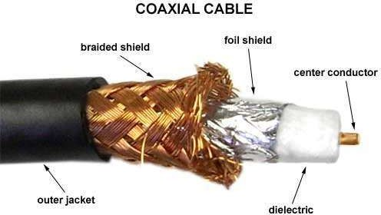
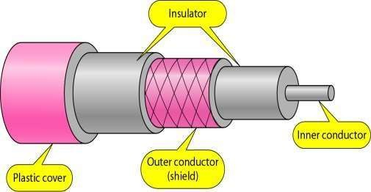
2. Coaxial Cable
Coaxial cable (or coax) carries signals of higher frequency
ranges than those in twisted pair cable.
Inner conductor is a solid wire
Outer conductor serves as a shield against noise and a second conductor

Slide 89
Contd..
Coaxial cable is very commonly used transmission media, for example, TV wire is usually a coaxial cable.
The name of the cable is coaxial as it contains two conductors parallel to each other.
It has a higher frequency as compared to Twisted pair cable.
The inner conductor of the coaxial cable is made up of copper, and the outer conductor is made up of copper mesh. The middle core is made up of non-conductive cover that separates the inner conductor from the outer conductor.
The middle core is responsible for the data transferring whereas the copper mesh prevents from the EMI(Electromagnetic interference).

Slide 90







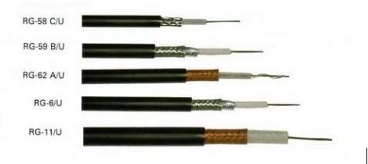
Categories of coaxial cables
Category | Use
RG-6 | Cable TV, Internet
RG-59 | CCTV
RG-11 | HDTV

Slide 91
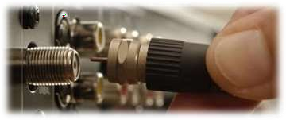
Coaxial Cable Applications
Long distance telephone transmission
Can carry 10,000 voice calls simultaneously
Short distance computer systems links - Local area networks
ADVANTAGES
DISADVANTAGES
Easy to wire
Easy to expand
Single cable failure can take down an entire network
Cost of installation of a coaxial cable is
high due to its thickness and stiffness
Cost of maintenance is also high

Slide 92
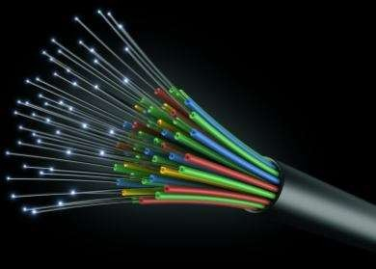
Fiber-Optic Cable
A fiber-optic cable is made of glass or plastic and transmits signals in the form of light. Light travels in a straight line as long as it is moving through a single uniform substance.
If a ray of light traveling through one substance suddenly enters another substance(of a different density), the ray changes direction.

Slide 93

Optical Fiber
consists of three concentric sections
_{plastic jacket} glass or plastic
cover
Fiber core and
clading
Core: consists of one or more very thin strands or fibers made of
glass or plastic
Each fiber is surrounded by its own cladding, a glass or plastic coating that has optical properties different from the core
Jacket: a plastic or other material acts as a layer to protect
against moisture, crushing, and other environmental dangers.

Slide 94

Fiber-Optic Cable(Contd.)
Optical fibers use reflection to guide light through a channel. A glass or plastic core is surrounded by a cladding of less dense glass or plastic.
An optical fiber cable has a cylindrical shape and consists of three concentric sections: the core, the cladding, and the jacket(outer part of the cable).

Slide 95

Areas of Application
Telecommunications
Local Area Networks
Cable TV
CCTV
Medical Education
22

Slide 96

Optical Fiber Disadvantages
Installation and maintenance need expertise
Only Unidirectional light propagation, two fibers are needed for bidirectional
Much more expensive
Optical FiberAdvantages
Greater capacity and Lower attenuation (signal loss)
Example: Data rates at 100 Gbps
Smaller size & light weight
A signal can run for 50 km without requiring regeneration. We need
repeaters every 5 km for coaxial or twisted-pair cable.
Highly Secure(no light leaking)

Slide 97


Slide 98

UNGUIDED MEDIA: WIRELESS
Unguided media transport electromagnetic waves without using a physical conductor. This type of communication is often referred to as wireless communication.
Radio Waves
Microwaves
Infrared

Slide 99

UNGUIDED MEDIA: WIRELESS
Unguided signals can travel from the source to destination in several ways: ground propagation, sky propagation, and line-of- sight propagation, as shown in Figure

Slide 100



Ground propagation:
Radio waves travel through the
lowest portion of the atmosphere
Touching the earth. Sky propagation:
Radio waves radiate to the ionosphere then they are reflected back to earth.
Line-of-Sight Propagation:
In straight lines directly from
antenna to antenna.
41

Slide 101

UNGUIDED MEDIA: WIRELESS

Slide 102

Unguided Media – Radio Waves
Omnidirectional Antenna
Frequencies between 3
KHz and 1 GHz.
Used for multicasts(multiple way) communications, such as radio and television, and paging system.
Radio waves can penetrate buildings easily, so that widely use for indoors & outdoors communication.
29

Slide 103


Infrared
Frequencies between 300 GHz to 400 THz.
Used for short-range communication
Example: Night Vision Camera,Remote control, File sharing between two phones, Communication between a PC and peripheral device,

Slide 104





Micro waves Transmission
Microwaves are unidirectional
Micro waves electromagnetic waves having frequency between 1 GHZ and 300 GHZ.
There are two types of micro waves data communication system
: terrestrial and satellite
Micro waves are widely used for one to one communication
between sender and receiver,
Example: cellular phone, satellite networks and in wireless LANs(wifi), GPS

Slide 105

Switched network
•
Switched
switches.
network: Series of interlinked nodes, called
•
Switches:
Devices capable of creating temporary
connections between two or more devices linked to the switches . Some of these switches are connected to the end systems ( computers or telephones) . Others used only for routing

Slide 106


Slide 107

SWITCHING DEFINITION
In a computer network where many different computers are connected to each other, there can be more than one path to send data from one computer to another. Selecting a path that data must take out of the available options is called switching.
There are three main switching techniques which are used. Circuit Switching, Message Switching and Packet Switching

Slide 108
1.Circuit Switching
In circuit switching circuit is established between the two ends. It provides a dedicated path for data to travel from one to the other end. Resources are reserved at intermediate switches which are used during the transmission.
The intermediate switches are connected by the physical links. Once the circuit is established, the entire data travels over the dedicated path from one end to the other end. As soon as data transfer completes, the circuit is disconnected
i.e. Three phases are need to communicate two parties or multiple parties in a conference call):
Connection setup
data transfer
Connection teardown

Slide 109


Slide 110
•
The setup phase: means creating dedicated channels between the switches.
•
Data Transfer Phase: After the establishment of the dedicated circuit (channels), the two parties can transfer data.
•
Teardown Phase: When one of the parties needs to disconnect, a signal is sent to each switch to release the resources.

Slide 111
Contd..
•
Circuit switching takes place at the physical layer
Data transferred between the two stations are not packetized. The data are a continuous flow sent by the source station and received by the destination station
•
•
There is no addressing involved during data transfer. Of course, there is end-to-end addressing used during the setup phase.

Slide 112
The advantages of Circuit Switching is that
A well defined and dedicated path exists for the data to travel.
There is no waiting time at any switch and the data is transmitted without any delay.
Data always reaches the other end in order.
Circuit switching has the following disadvantages-
The channel is blocked for duration of transmission.
It is inefficient in terms of utilization of system resources.
The time required for establishing the circuit between the two ends is too long.
It requires more bandwidth and is more expensive

Slide 113

Delay

Slide 114
2. Message Switching
In message switching there is no dedicated path to transfer data from sender to receiver. The message carries a header that contains the full information about the destination.
The message is only forwarded from hop to hop. When any intermediate switch receives the message, it stores the entire message.
The message is stored until sufficient resources become available to transfer it to the next switch. When resources become available, the switch forwards the message to the next switch. This is called as Store and Forward technique.
Each and every node stores the entire message and then forward it to the next node. This type of network is known as store and forward network.
Message switching treats each message as an independent entity.

Slide 115

2. Message Switching

Slide 116
The advantages of Message Switching is that the
Channel is not blocked and more devices can share the channel
It is helpful in reducing traffic congestion as the message can be temporarily stored in the route and then forwarded whenever required.
The disadvantages of Message Switching are
It requires enough storage at every switch to accommodate the entire message during the transmission.
It is extremely slow due to store and forward technique
Message has to wait until sufficient resources become available to transfer it to the next switch.

Slide 117
3.Packet Switching
The packet switching is a switching technique in which the message is divided into smaller pieces, and they are sent individually.
The message splits into smaller pieces known as packets and packets are given a unique number to identify their order at the receiving end.
Every packet contains some information in its headers such as source address, destination address and sequence number.
Packets will travel across the network, taking the shortest path as possible.
All the packets are reassembled at the receiving end in correct order.
If any packet is missing or corrupted, then the message will be sent to resend the message.
If the correct order of the packets is reached, then the acknowledgment message will be sent.

Slide 118

3.Packet Switching

Slide 119
Approaches Of Packet Switching:
1. Datagram Packet switching:
It is a packet switching technology in which packet is known as a datagram, is considered as an independent entity. Each packet contains the information about the destination and switch uses this information to forward the packet to the correct destination.
The packets are reassembled at the receiving end in correct order.
In Datagram Packet Switching technique, the path is not fixed.
Intermediate nodes take the routing decisions to forward the packets.
Datagram Packet Switching is also known as connectionless switching.

Slide 120

DATAGRAM NETWORKS
Each packet (called as datagrams in this approach) is treated independently of all others
All packets (or datagrams) belong to the same message may travel different paths to reach their destination .
•
•

Slide 121
2. Virtual Circuit Switching
Virtual Circuit Switching is also known as connection-oriented switching.
In the case of Virtual circuit switching, a preplanned route is established before the messages are sent.
Call request and call accept packets are used to establish the connection between sender and receiver.
In this case, the path is fixed for the duration of a logical connection
Let's understand the concept of virtual circuit switching through a diagram:

Slide 122


Slide 123
Contd..
In the above diagram, A and B are the sender and receiver respectively. 1 and 2 are the nodes.
Call request and call accept packets are used to establish a connection between the sender and receiver.
When a route is established, data will be transferred.
After transmission of data, an acknowledgment signal is sent by the receiver that the message has been received.
If the user wants to terminate the connection, a clear signal is sent for the termination.

Slide 124

VIRTUAL-CIRCUIT NETWORKS
It’s a
cross between circuit switched network
and datagram
network, and has some characteristics of both.
▪
Characteristics:
Packets from a single message travel along the same path.
Three phases to transfer data (set up, data transfer and tear down)
Resources can be allocated during setup phase
Data are packetized and each packet carries an address in the
header
Implemented in data link layer

Slide 125
Advantages Of Packet Switching:
Cost-effective: In packet switching technique, switching devices do not require massive secondary storage to store the packets, so cost is minimized to some extent. Therefore, we can say that the packet switching technique is a cost-effective technique.
Reliable: If any node is busy, then the packets can be rerouted. This ensures that the Packet Switching technique provides reliable communication.
Efficient: Packet Switching is an efficient technique. It does not require any established path prior to the transmission, and many users can use the same communication channel simultaneously, hence makes use of available bandwidth very efficiently.

Slide 126
Disadvantages of packet switching:
Packet Switching technique cannot be implemented in those applications that require low delay and high-quality services.
The protocols used in a packet switching technique are very complex and requires high implementation cost.
If the network is overloaded or corrupted, then it requires retransmission of lost packets. It can also lead to the loss of critical information if errors are nor recovered.

Slide 127


Slide 128
History of Internet
More than 100 countries use the Internet. Millions of people are users. Yet this extraordinary communication system only came into being in 1969.
In the mid-1960s, mainframe computers in research organizations were standalone devices. Computers from different manufacturers were unable to communicate with one another.
The Advanced Research Projects Agency(ARPA) in the Department of Defense (DoD) was interested in finding a way to connect computers so that the researchers they funded could share their findings, thereby reducing costs and eliminating duplication of effort

Slide 129
In 1967, at an Association for Computing Machinery (ACM) meeting, ARPA presented its ideas . The idea was that each host computer (not necessarily from the same manufacturer) would be attached to a specialized computer, called an interface message processor (IMP).
Each IMP had to be able to communicate with other IMPs as well
as with its own attached host. By 1969, ARPANET was a reality.
Four nodes, at the University of California at Los Angeles (UCLA), the University of California at Santa Barbara (UCSB), Stanford Research Institute (SRI), and the University of Utah, were connected via the IMPs to form a network. Software called the Network Control Protocol (NCP) provided communication between the hosts.

Slide 130
INTERNET
Internet is called the network of networks. It is a global communication system that links together thousands of individual networks.
In other words, internet is a collection of interlinked computer networks, connected by copper wires, fiber-optic cables, wireless connections, etc.
As a result, a computer can virtually connect to other computers in any network. These connections allow users to interchange messages, to communicate in real time (getting instant messages and responses), to share data and programs and to access limitless information.

Slide 131
Basics of Internet Architecture
Internet architecture is a meta-network, which refers to a congregation of thousands of distinct networks interacting with a common protocol. In simple terms, it is referred as an internetwork that is connected using protocols. Protocol used is TCP/IP.
protocol connects any two networks that differ in hardware, software and design.
TCP/IP provides end to end transmission, i.e., each and every node on one network has the ability to communicate with any other node on the network.

Slide 132

Layers of Internet Architecture
Internet architecture consists of three layers.
IP:(Internet protocol)
In order to communicate, we need our data to be encapsulated as Internet Protocol (IP) packets. These IP packets travel across number of hosts in a network through routing to reach the destination. However IP does not support error detection and error recovery, and is incapable of detecting loss of packets.

Slide 133
Contd..
TCP
TCP stands for "Transmission Control Protocol". It provides end to end transmission of data, i.e., from source to destination. It is a very complex protocol as it supports recovery of lost packets.
Application Protocol
Third layer in internet architecture is the application layer which has different protocols on which the internet services are built. Some of the examples of internet services include email (SMTP facilitates email feature), file transfer (FTP facilitates file transfer feature), etc

Slide 134
THE INTERNET TODAY
The Internet has come a long way since the 1960s. The Internet today is not a simple hierarchical structure. It is made up of many wide- and local-area networks joined by connecting devices and switching stations.
It is difficult to give an accurate representation of the Internet because it is continually changing-new networks are being added, existing networks are adding addresses, and networks of defunct companies are being removed.
Today most end users who want Internet connection use the services of Internet service providers (lSPs). There are international service providers, national service providers, regional service providers, and local service providers.

Slide 135
In 1972, Vint Cerf and Bob Kahn, both of whom were part of the core ARPANET group, collaborated on what they called the Internetting Projec1
Cerf and Kahn's landmark 1973 paper outlined the protocols to achieve end- to-end delivery of packets. This paper on Transmission Control Protocol (TCP) included concepts such as encapsulation, the datagram, and the functions of a gateway.
Shortly thereafter, authorities made a decision to split TCP into two protocols: Transmission Control Protocol (TCP) and Internetworking Protocol (lP). IP would handle datagram routing while TCP would be responsible for higher-level functions such as segmentation, reassembly, and error detection. The internetworking protocol became known as TCPIIP.

Slide 136

The Internet today is run by private companies, not the government. Below figure shows a conceptual (not geographic) view of the Internet.

Slide 137


